Slide 1


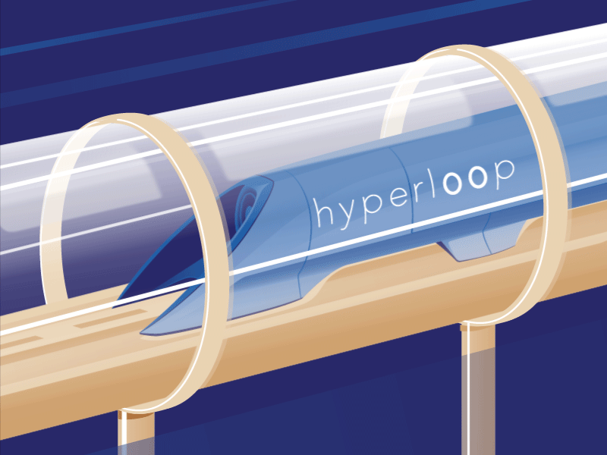
Seminar
HYPERLOOP TECHNOLOGY
THE FIFTH MODE OF TRANSPORTATION
Guide:
Mrs. Shivaranjani Somashekar
Asst. Professor, Dept. of CSE
Presented By:
Vaishnavi Vivek
(1RG17CS064)

Slide 2
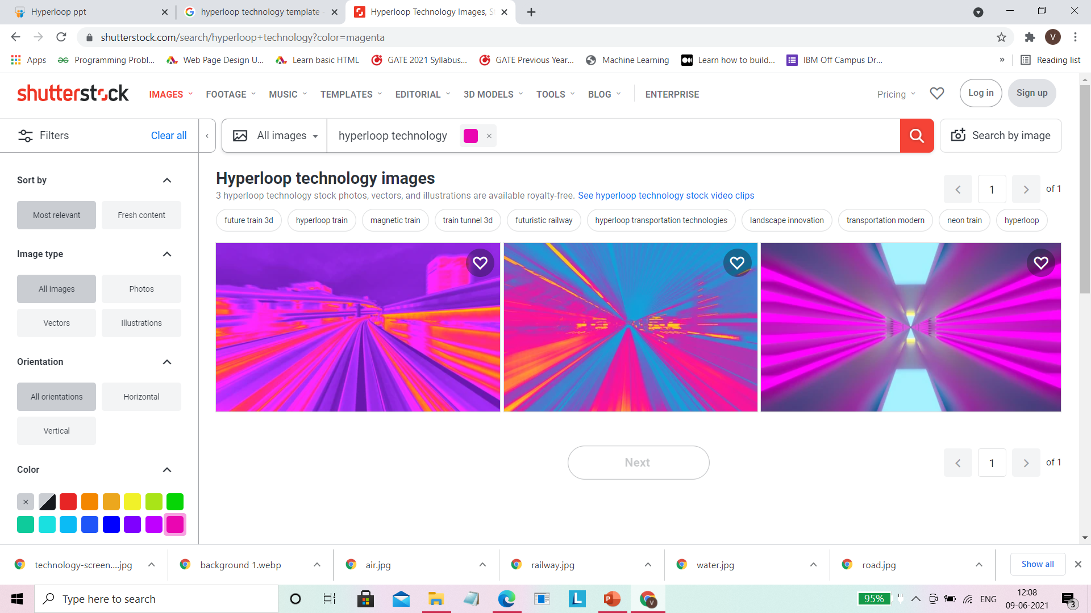
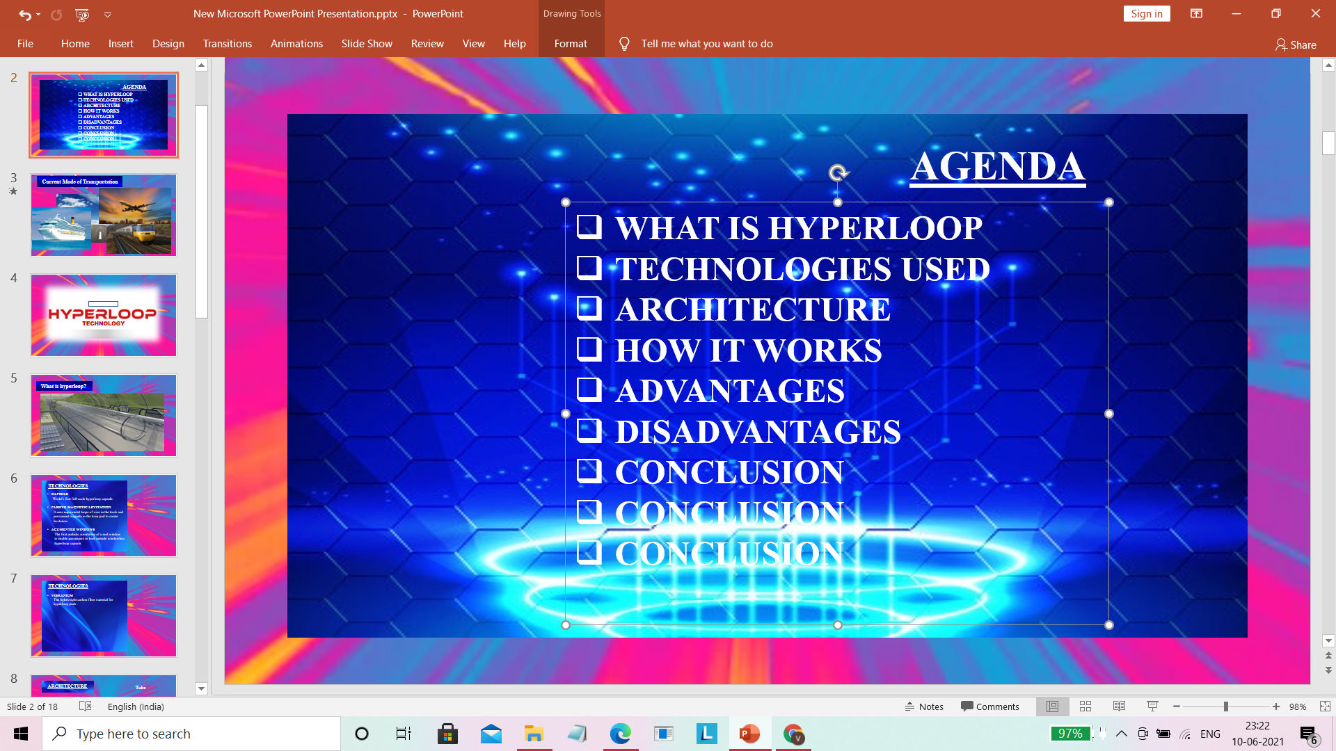

CONTENTS
CONCEPT
WHAT IS HYPERLOOP ?
WHOSE IDEA ?
TECHNOLOGY
HOW IT WORKS
ADVANTAGES
DISADVANTAGES
PROGRESS
CONCLUSION

Slide 3

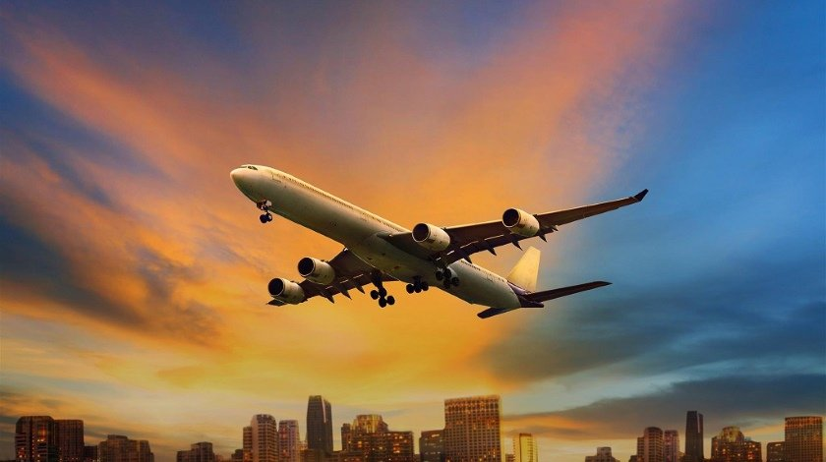

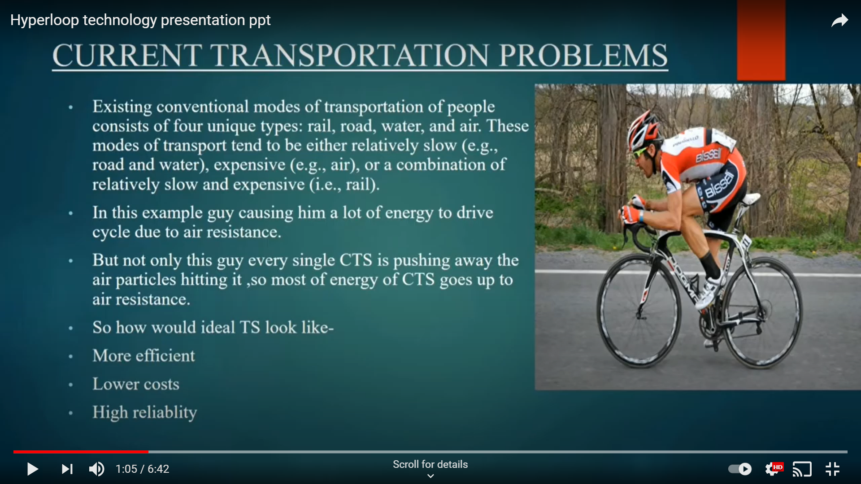
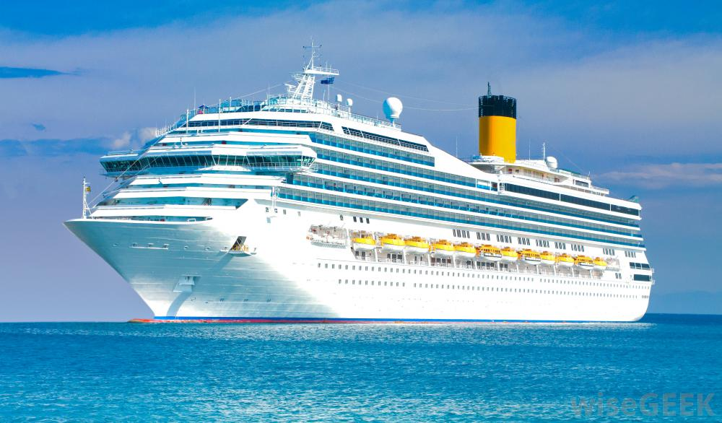
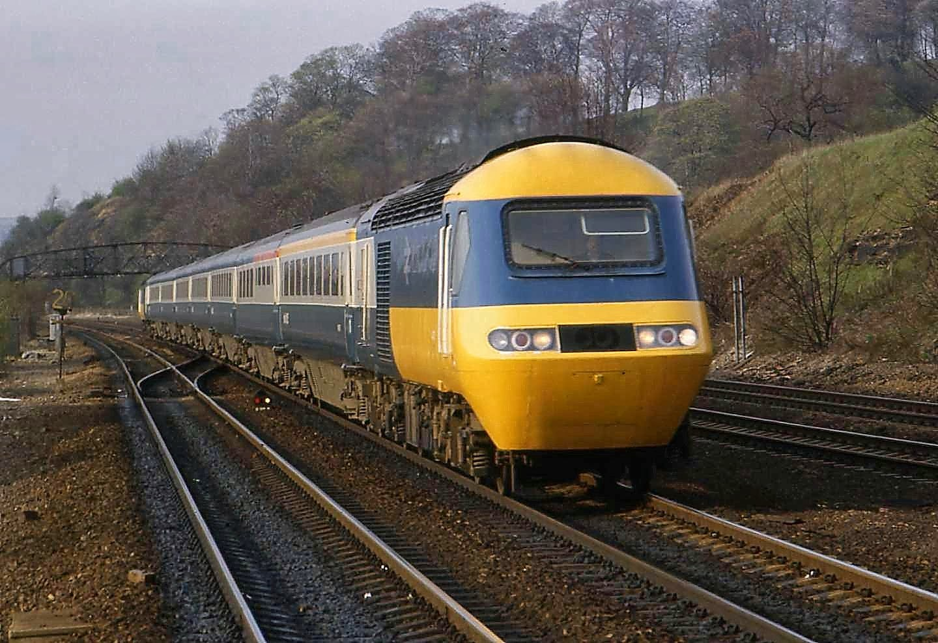
CURRENT MODES OF TRANSPORTATION

Slide 4
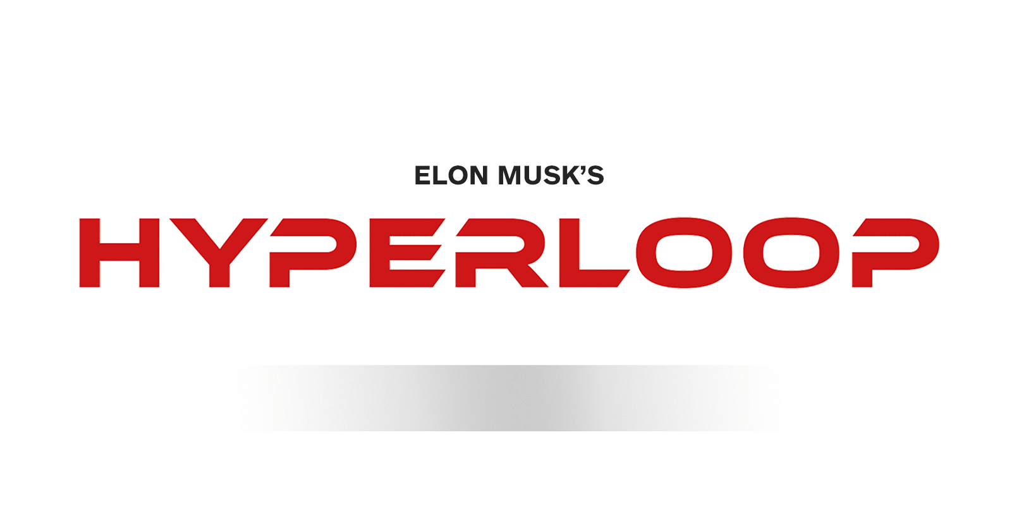
TECHNOLOGY

Slide 5
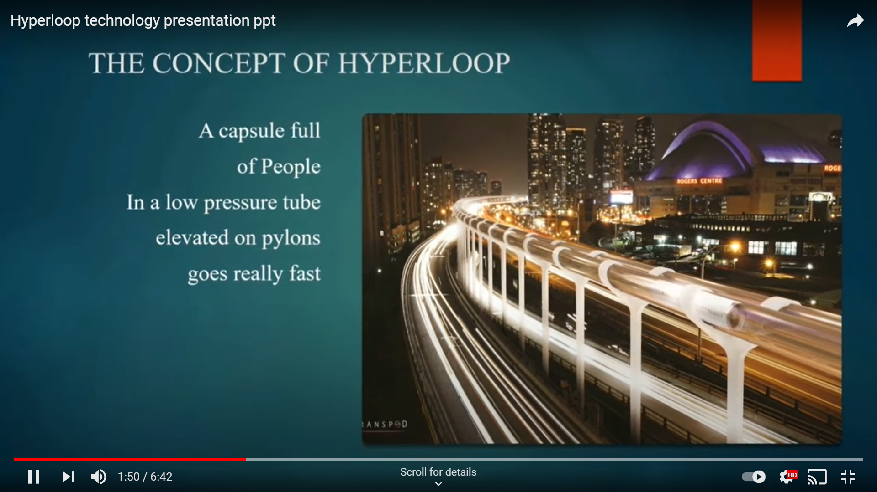
THE CONCEPT…
A Hyperloop would be an elevated, low-pressure tube with capsules.

Slide 6
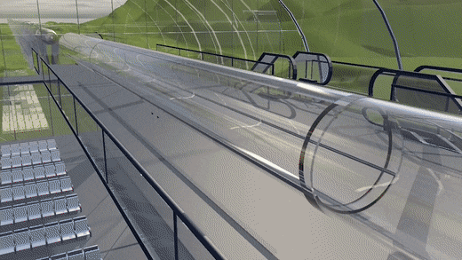
WHAT IS HYPERLOOP?
Hyperloop aims to be the new mode of passenger and freight transport .
Capsules are supported on a cushion of air.
Elevated system of transportation.
Entry and Exit of passengers.

Slide 7
WHOSE IDEA ?
“ELON MUSK”

Slide 8
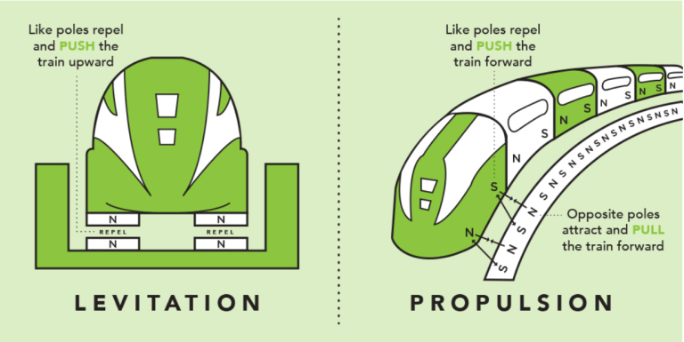
TECHNOLOGY
PASSIVE MAGNETIC LEVITATION
It uses an array of permanent magnets in the train pod and steel track to create levitation.
PROPULSION
The capsules will accelerate at a very high speed due to aerodynamic drag.

Slide 9
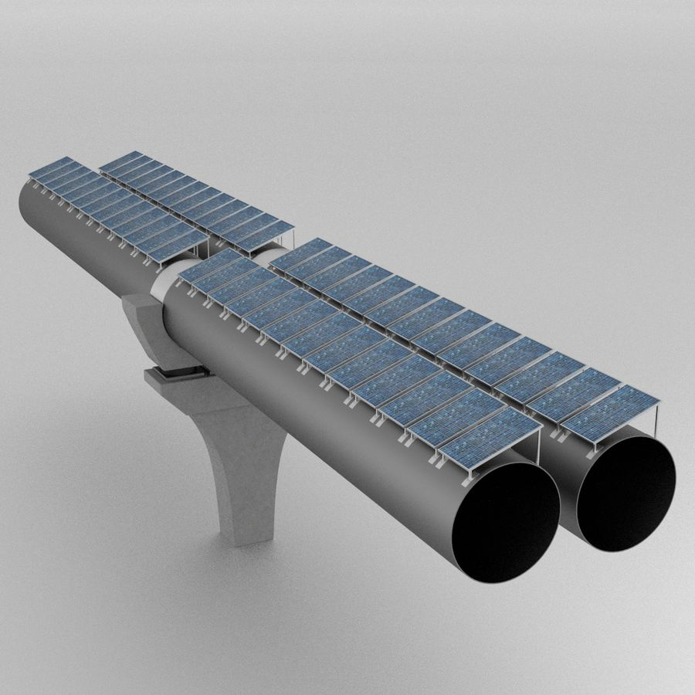
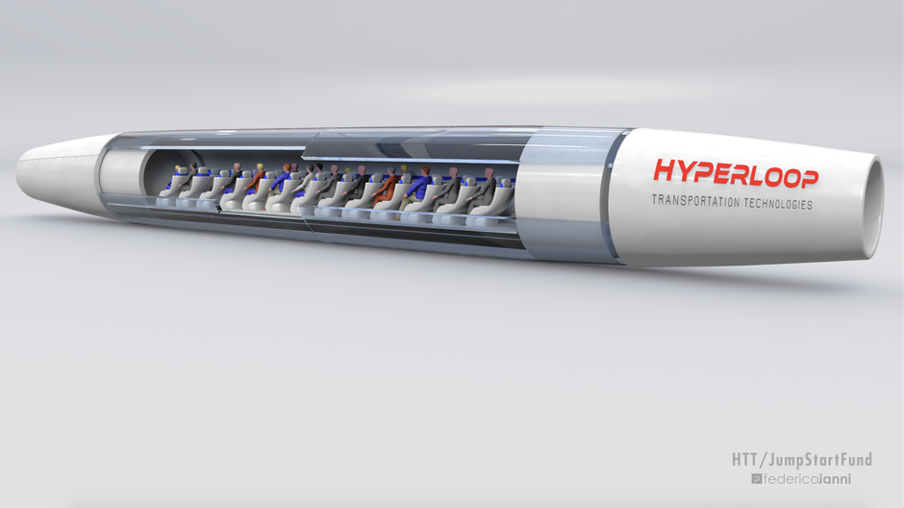
COMPONENTS
Tubes with Solar Array Panels
Capsule

Slide 10
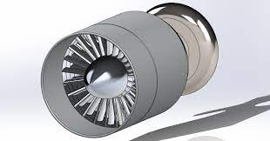
COMPONENTS
Compressor
The solution to overcome the drag of capsule

Slide 11
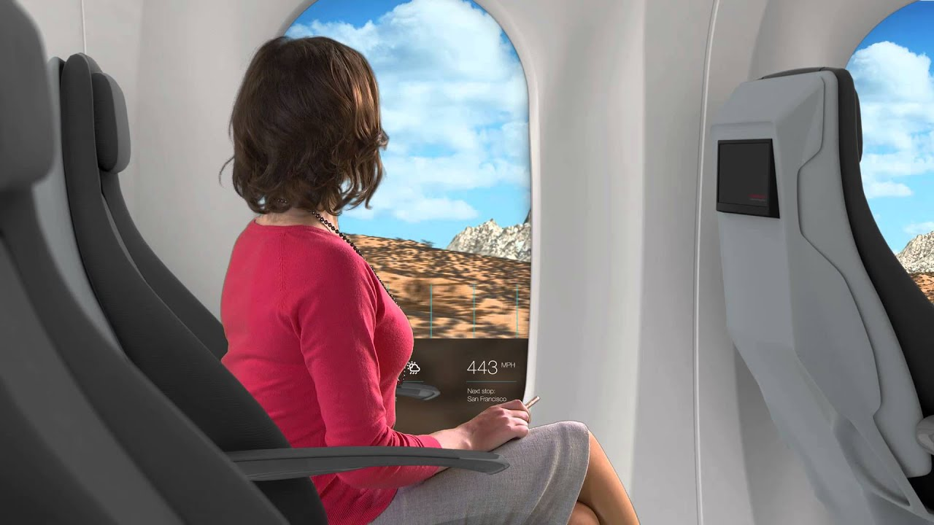
AUGMENTED WINDOWS
Interactive AR screens open up the windowless capsule to the outside world.

Slide 12
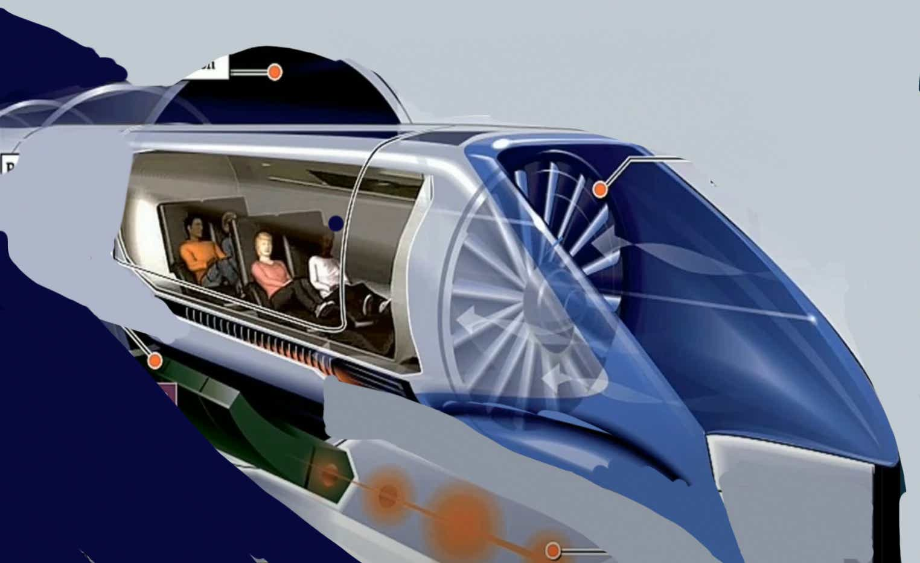
How It Works?

Slide 13
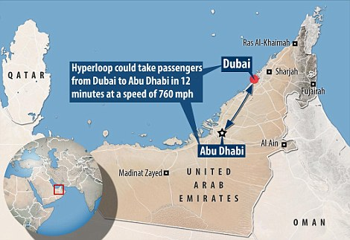
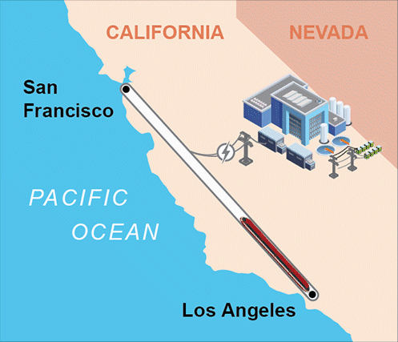
PROGRESS IN HYPERLOOP PROJECTS

Slide 14
DEVELOPMENT OF HYPERLOOP IN INDIA
Amravati to Vijayawada
Bengaluru to Chennai
Mumbai to Pune
Mumbai to Chennai

Slide 15
SPEED COMPARISION
Type | Max Speed (Km/h)
Aircraft | 980
Bus | 100
Car | 120
Train | 225
Metro Rail | 380
Maglev | 431
Hyperloop | 1200

Slide 16
ADVANTAGES
Low cost than flights and high speed trains.
Highest speed than all transportation methods.
Immune to weather
Resistant to Earthquakes.
Sustainable self powering.
Pollution free.

Slide 17
DISADVANTAGES
Dizziness due to high speed.
Insufficient movable space for passengers.
Environment loss.

Slide 18
CONCLUSION
The futuristic transportation system is yet to become an everyday reality. As Hyperloop is a new concept, it would require some future work for development of this project. Hyperloop is the first new form of public transportation in over 100 years. Hyperloop Technology will fundamentally change the way we travel, work and live.

Slide 19

THANK YOU

